Slide 1


Slide 2

RULES 2017+
TRAVELLING
Version 1.0 / 10 August 2017
OBR 2017

Slide 3
NOTE
This material is created by FIBA Referee Department and should not be edited unless using so called ”open template” without FIBA logo.
See document “FIBA_Powerpoint_Presentations” for details.
If you identify an error or a discrepancy in this material, please notify the FIBA Referee Department at refereeing@fiba.com.
FIBA Referee Department

Slide 4
SymbolS

Slide 5









SYMBOLS & definitions
PLAYER CONTROL THE BALL FOOT ON THE FLOOR
STATIONARY FOOT ON THE FLOOR
FOOT IN THE AIR
FIRST STEP TOUCHING THE FLOOR
SECOND STEP TOUCHING THE FLOOR
CONTROL THE BALL IN THE AIR
PIVOT FOOT

Slide 6
ART 25. TRAVELING
RULE

Slide 7
ART. 25 RULE (1)
25.1 Definition
25.1.1. Travelling is the illegal movement of one foot or both feet beyond the limits outlined in this article, in any direction, while holding a live ball on the playing court.
25.1.2 A pivot is the legal movement in which a player who is holding a live ball on the playing court steps once or more than once in any direction with the same foot, while the other foot, called the pivot foot, is kept at its point of contact with the floor.

Slide 8
ART. 25 RULE (2)
25.1.3
Establishing a pivot foot by a player who catches a live ball on the playing court:
If a player who receives the ball while standing with both feet on the floor:
The moment one foot is lifted, the other foot becomes the pivot foot.
To start a dribble, the pivot foot may not be lifted before the ball is released from the hand(s).
To pass or shoot for a field goal, the player may jump off a pivot foot, but neither foot may be returned to the floor before the ball is released from the hand(s).

Slide 9
ART. 25 RULE (3)
If a player who receives the ball while he is progressing upon completion of a dribble may take two steps in coming to a stop, passing or shooting the ball:
  If receiving the ball the player shall release the ball to start his dribble before his second step.
  The first step occurs when one foot or both feet, touch the floor after gaining control of the ball.
  The second step occurs after the first step when the other foot touches the floor, or both feet touch the floor simultaneously.
  If the player who comes to a stop on his first step has both feet on the floor or they touch the floor simultaneously may pivot using either foot as his pivot foot. If he then jumps with both feet no foot may return to the floor before the ball is released from the hand(s).

Slide 10
ART. 25 RULE (4)
  If a player lands with one foot first he may only pivot using that foot.
  If a player jumps off one foot on the first step he may land with both feet simultaneously for the second step. In this situation, the player may not pivot with either foot. If one foot or both feet then leave the floor no foot may return to the floor before the ball is released from the hand(s).
  If both feet are off the floor and the player lands on both feet simultaneously, the moment one foot is lifted, the other foot becomes the pivot foot.
  A player may not touch the floor consecutively with the same foot or both feet, after ending his dribble or gaining control of the ball.

Slide 11
ART. 25 RULE (5)
  25.2.2. A player falling. lying or sitting on the floor:
  It is legal when a player falls and slides on the floor while holding the ball or, while lying or sitting on the floor, gains control of the ball.
  It is a violation if the player then rolls or attempts to stand up while holding the ball

Slide 12
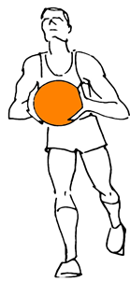
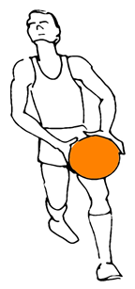
The change - ART. 25 TRAVELLING
  OLD:
  WHILE gaining control of the ball
  2017+ NEW:
  AFTER gaining control of the ball

Slide 13
receives the ball while standing with both feet on the floOR

Slide 14
ART. 25 TRAVELLING
25.2.1 Establishing a pivot foot by a player who catches a live ball on the playing court:
If a player who receives the ball while standing with both feet on the floor:
The moment one foot is lifted, the other foot becomes the pivot foot.
To start a dribble, the pivot foot may not be lifted before the ball is released from the hand(s).
To pass or shoot for a field goal, the player may jump off a pivot foot, but neither foot may be returned to the floor before the ball is released from the hand(s).

Slide 15


1 - WHILE STANDING WITH BOTH FEET ON THE FLOOR
A PLAYER WHO RECEIVES THE BALL WITH BOTH FEET ON THE FLOOR
OR
OR

Slide 16

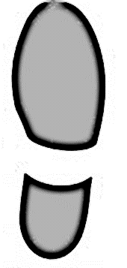

1 - WHILE STANDING WITH BOTH FEET ON THE FLOOR
LEGAL
A PLAYER WHO CATCHES A LIVE BALL
If both feet are off the floor and the player lands on both feet simultaneously,
The moment one foot is lifted, the other foot becomes the pivot foot.

Slide 17
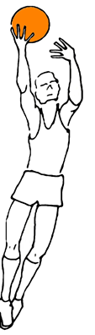

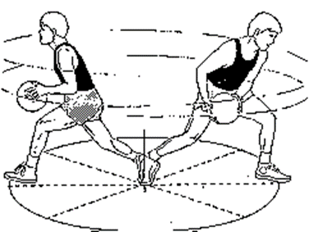
WHILE STANDING
LEGAL
1
2
To pass or shoot for a field goal, the player may jump off a pivot foot, but neither foot may be returned to the floor before the ball is released from the hand(s).

Slide 18
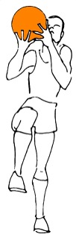
WHILE STANDING
ILLEGAL
2
1
To pass or shoot for a field goal, the player may jump off a pivot foot, but neither foot may be returned to the floor before the ball is released from the hand(s).

Slide 19

2 - START DRIBBLE - STATIONARY
LEGAL
To start a dribble, the pivot foot may not be lifted before the ball is released from the hand(s).
1
2

Slide 20
2 - START DRIBBLE - STATIONARY
ILLEGAL
To start a dribble, the pivot foot may not be lifted before the ball is released from the hand(s).
2
1

Slide 21
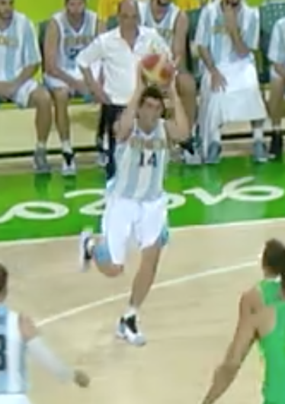
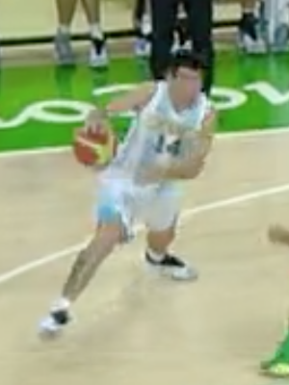
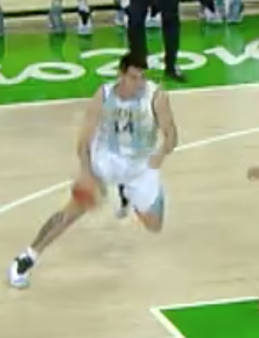
2 - START DRIBBLE - STATIONARY
ILLEGAL
To start a dribble, the pivot foot may not be lifted before the ball is released from the hand(s).

Slide 22
RECEIVES THE BALL WHILE IS PROGRESSING OR COMPLETION OF A DRIBBLE

Slide 23

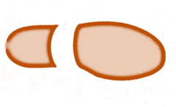


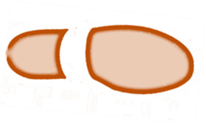

GENERAL PRINCIPLE
CONTROL –> FIRST STEP –> SECOND STEP
1 ACTION 0 STEP | 2 ACTIONS 1 STEP | 3 ACTIONS 2 STEP
NO STOP | If a player lands with one foot first he may only pivot using that foot.
1S
2S
2S
1S
The second step occurs after the first step when the other foot touches the floor, or both feet touch the floor simultaneously
  Gaining control of the ball.
  The first step occurs when one foot or both feet, touch the floor after gaining control of the ball.

Slide 24
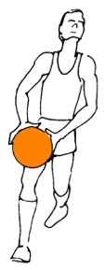


GENERAL PRINCIPLE
GAINING CONTROL OF THE BALL
1 ACTION 0 STEP | 1 ACTIONS 0 STEP
NO STOP | WHEN GAINING CONTROL THE BALL
OR

Slide 25

GENERAL PRINCIPLE
GAINING CONTROL OF THE BALL
1 ACTION 0 STEP | 1 ACTION 0 STEP
BALL IN THE AIR | WHEN GAINING CONTROL OF THE BALL IN THE AIR

Slide 26

1 - START DRIBBLE - MOVING
LEGAL
1 ACTION 0 STEP | 1 ACTIONS 1 STEP
WHEN GAINING CONTROL THE BALL
  If receiving the ball the player shall release the ball (1) to start his dribble before his second step (2) .
2
1

Slide 27
START DIBLLING WHILE MOVING
1 ACTION 0 STEP | 2 ACTIONS 1 STEP | 3 ACTIONS 2 STEP
NO STOP | If a player lands with one foot first he may only pivot using that foot.
1S
2S
RELEASE THE BALL
2S
1S
The second step occurs after the first step when the other foot touches the floor, or both feet touch the floor simultaneously
  Gaining control of the ball.
  The first step occurs when one foot or both feet, touch the floor after gaining control of the ball.

Slide 28
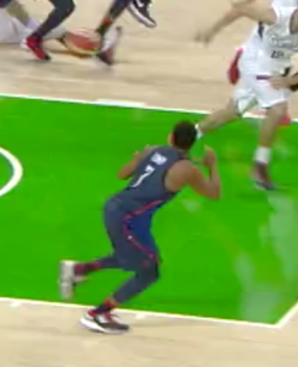
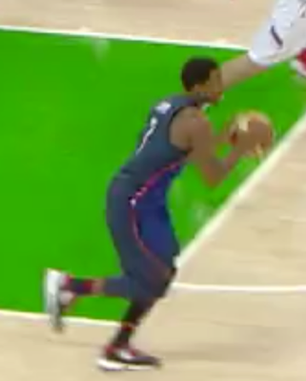
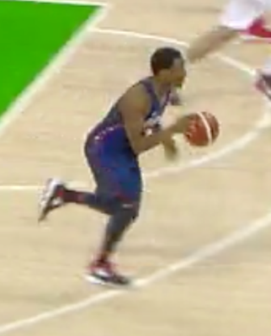
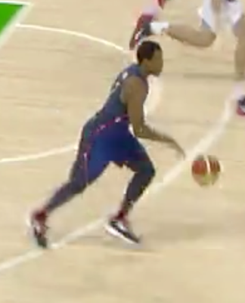
1 - START DRIBBLE - MOVING
0
Left
1
RIGHT
1st step
2
Release the ball before 2nd step

Slide 29






2 - 5 GENERAL PRINCIPLE
1 STEP COMPLETION OF A DRIBBLE
LEGAL
1 ACTION 0 STEP | 2 ACTIONS 1 STEP | 2 ACTIONS 1 STEP
NO STOP | If a player lands with one foot first he may only pivot using that foot. | FREE PIVOT FOOT
OR
  The first step occurs when one foot or both feet, touch the floor after gaining control of the ball.

Slide 30
3 – 5 GENERAL PRINCIPLE
1 / 2 STEP COMPLETION OF A DRIBBLE
LEGAL
1 ACTION 0 STEP | 2 ACTIONS 1 STEP | 3 ACTIONS 2 STEP
NO STOP | If a player lands with one foot first he may only pivot using that foot.
1S
2S
2S
1S
The second step occurs after the first step when the other foot touches the floor, or both feet touch the floor simultaneously

Slide 31

2 - 5 GENERAL PRINCIPLE
1 STEP COMPLETION OF A DRIBBLE
LEGAL
1st ACTION 0 STEP | 2nd ACTION 1 STEP
NO STOP | If a player lands with one foot first he may only pivot using that foot. | FREE PIVOT FOOT
  The first step occurs when one foot or both feet, touch the floor after gaining control of the ball.

Slide 32


3 – 5 GENERAL PRINCIPLE
1 / 2 STEP COMPLETION OF A DRIBBLE
LEGAL
PLAYER IN THE AIR | 1st ACTION 1 STEP- PIVOT FOOT | 2nd ACTION 2 STEP
AFTER GAINING CONTROL THE BALL | If a player lands with one foot first he may only pivot using that foot.
2S
2S
  The first step occurs when one foot or both feet, touch the floor after gaining control of the ball.
The second step occurs after the first step when the other foot touches the floor, or both feet touch the floor simultaneously

Slide 33
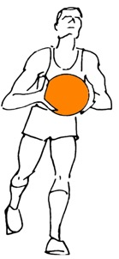

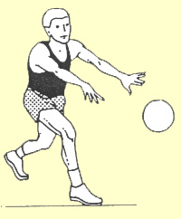





3 - GENERAL PRINCIPLE
1 / 2 STEP COMPLETION OF A DRIBBLE
LEGAL
1st ACTION 0 STEP | 2nd ACTION 1 STEP AFTER GAINING CONTROL THE BALL | 3rd ACTIONS 2 STEP
NO STOP | PIVOT FOOT | PASSING OR SHOTING
OR

Slide 34
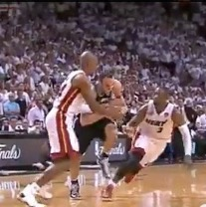
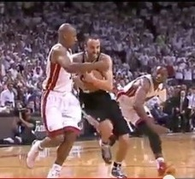
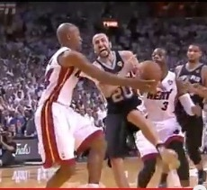
1 ACTION – O STEP
2 ACTION – 1 STEP
PIVOT FOOT
3 ACTION – 2 STEP

Slide 35

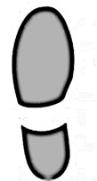

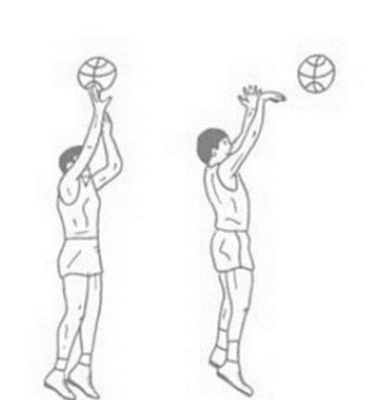

COMPLETION OF A DRIBBLE
STOP ON THE FIRST STEP
LEGAL
1st ACTION 0 STEP | 2nd ACTION 1 STEP
NO STOP | PIVOT FOOT – FREE If both feet are off the floor and the player lands on both feet simultaneously, the moment one foot is lifted, the other foot becomes the pivot foot
STOP
OR
If the player who comes to a stop on his first step has both feet on the floor or they touch the floor simultaneously may pivot using either foot as his pivot foot. If he then jumps with both feet no foot may return to the floor before the ball is released from the hand(s).

Slide 36






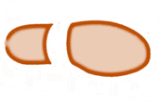



COMPLETION OF A DRIBBLE
STOP ON THE SECOND STEP
LEGAL
1 ACTION 0 STEP | 2 ACTIONS 1 STEP AFTER GAINING CONTROL THE BALL | 3 ACTIONS 2 STEP
NO STOP |  | NO PIVOT FOOT
OR
  If a player jumps off one foot on the first step he may land with both feet simultaneously for the second step. In this situation, the player may not pivot with either foot. If one or both feet then leave the floor no foot may return to the floor before the ball is released from the hand(s).

Slide 37


6 - GENERAL PRINCIPLE
PROGRESSING OR COMPLETION OF A DRIBBLE
ILLEGAL
1 ACTION 0 STEP | 2 ACTIONS 1 STEP | 3 ACTIONS 2 STEP
NO STOP |  | NO PIVOT FOOT
OR
OR
  If a player jumps off one foot on the first step he may land with both feet simultaneously for the second step. In this situation, the player may not pivot with either foot. If one or both feet then leave the floor no foot may return to the floor before the ball is released from the hand(s).

Slide 38



8 – GENERAL PRINCIPLE
CONSECUTIVELY WITH THE SAME FOOT
ILLEGAL
1st ACTION 0 STEP | 2nd ACTION 1 STEP | 3rd ACTION 2 STEP
NO STOP
Left
Left
  A player may not touch the floor consecutively with the same foot or both feet, after ending his dribble or gaining control of the ball.

Slide 39
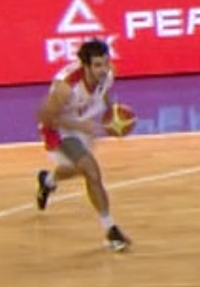
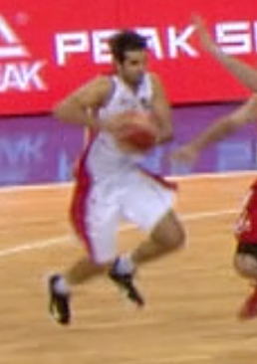
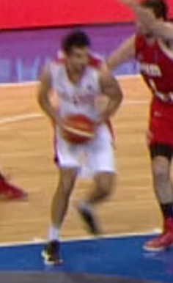
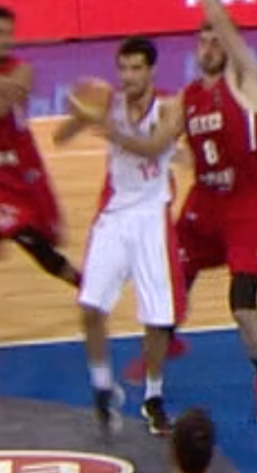
8 – GENERAL PRINCIPLE
CONSECUTIVELY WITH THE SAME FOOT
ILLEGAL

Slide 40




REVERSE SPIN MOVE
LEGAL

Slide 41
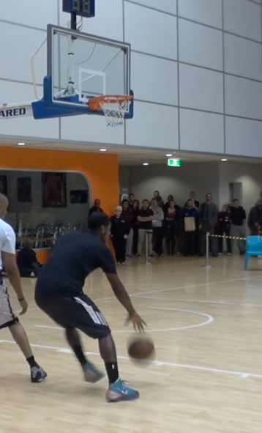
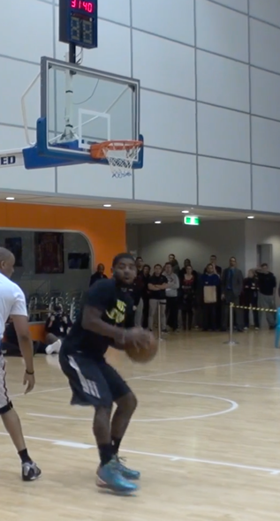
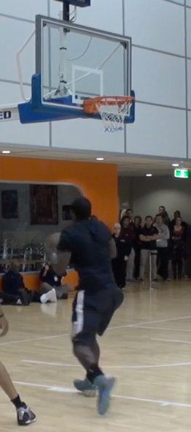
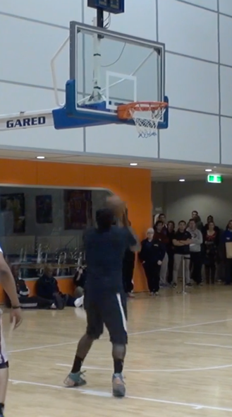
REVERSE Spin move
LEGAL
0
1
2
Left
RIGHT
1st step
LEFT
2nd step

Slide 42


